Slide 1
Project Operating Systems Scheduling Algorithm
01
02
03
Mateo Sheme
04

Slide 2
Table of Contents
01
03
02
04
Algorithm Comparaison
01
Algorithm Code
SJF (preemptive) and SJF (non preemptive) for AWT and TAT
C++ code for the scheduling algorithms
02
Generalities
Simulator
03
Generalities printed in c++ about me
A visual simulator for one of the algorithms
04

Slide 3
01
Algorithm Comparaison
01
02
03
04

Slide 4
Abstract
What you’ll find in this project is solved algorithms of 2 types of CPU Scheduling. For Short Job First Preemptive and Short Job First Non-Preemptive, I am going to be calculating Average Waiting Time and Average Turn Around Time of each algorithm, with given parameters. Then we will do a comparison of final results between algorithms and give a brief explanation of these findings. Besides that I also going show a program in C++ printing Generalities of me. Finally, I am going to show another program in C++ about one of the scheduling algorithm printed out along with a simulator for one of them.
01
02
03
04

Slide 5
Shortest Job First (Preemptive)
How it works
01
Each process entered executes based on the arrival of the other one. In case of wondering which process is next, the one with the lowest burst time is picked first.
Processes | Arrival Time | Burst Time | Priority
P1 | 0 | 15 | 2
P2 | 2 | 2 | 0
P3 | 4 | 4 | 2
P4 | 5 | 2 | 3
P5 | 7 | 8 | 1
02
03
04

Slide 6
Shortest Job First (Preemptive)
Calculations
01
Turnaround time (TAT) = Completion Time (CT) - Arrival Time (AT)
Waiting Time (WAT) = Turnaround Time (TAT) - Burst Time (BT)
Processes | AVG (TAT) = 10.4 | AVG (WAT) = 4.2
P1 | 31 - 0 = 31 | 31 - 15 = 16
P2 | 4 - 2 = 2 | 2 - 2 = 0
P3 | 10 - 4 = 6 | 6 - 4 = 2
P4 | 7 - 5 = 2 | 2 - 2 = 0
P5 | 18 - 7 = 11 | 11 - 8 = 3
02
03
04

Slide 7
Shortest Job First (Preemptive)
Calculations with context switch of 2 ns
01
Turnaround time (TAT) = Completion Time (CT) - Arrival Time (AT)
Waiting Time (WAT) = Turnaround Time (TAT) - Burst Time (BT)
Processes | AVG (TAT) = 10.6 × 10⁻⁶ | AVG (WAT) = 4.4 × 10⁻⁶
P1 | 31 + 0.2 = 31.2 × 10⁻⁶ | 16 + 0.2 = 16.2 × 10⁻⁶
P2 | 2 + 0.2 = 2.2 × 10⁻⁶ | 0 + 0.2 = 0.2 × 10⁻⁶
P3 | 6 + 0.2 = 6.2 × 10⁻⁶ | 2 + 0.2 = 2.2 × 10⁻⁶
P4 | 2 + 0.2 = 2.2 × 10⁻⁶ | 0 + 0.2 = 0.2 × 10⁻⁶
P5 | 11 + 0.2 = 11.2 × 10⁻⁶ | 3 + 0.2 = 3.2 × 10⁻⁶
02
03
04

Slide 8
Gantt Chart
P2
P3
P4
P7
SFJ Pre | 01 | 02 | 03 | 04 | 05 | 06 | 07 | 08 | 09 | 10 | 11 | 12 | 13 | 14 | 15 | 16
P1
P2
P3
P4
P5
01
02
SFJ Pre | 17 | 18 | 19 | 20 | 21 | 22 | 23 | 24 | 25 | 26 | 27 | 28 | 29 | 30 | 31 | 32
P1
P2
P3
P4
P5
03
04

Slide 9
Shortest Job First (Non-Preemptive)
How it works
01
Each process entered executes the whole burst time without interruption. In case of wondering which process is next, it's the same, the one with the lowest burst time is picked first.
Processes | Arrival Time | Burst Time | Priority
P1 | 0 | 15 | 2
P2 | 2 | 2 | 0
P3 | 4 | 4 | 2
P4 | 5 | 2 | 3
P5 | 7 | 8 | 1
02
03
04

Slide 10
Shortest Job First (Non-Preemptive)
Calculations
01
Turnaround time (TAT) = Completion Time (CT) - Arrival Time (AT)
Waiting Time (WAT) = Turnaround Time (TAT) - Burst Time (BT)
Processes | AVG (TAT) = 17.4 | AVG (WAT) = 11.2
P1 | 15 - 0 = 15 | 15 - 15 = 0
P2 | 17 - 2 = 15 | 15 - 2 = 13
P3 | 23 - 4 = 19 | 19 - 4 = 15
P4 | 19 - 5 = 14 | 14 - 2 = 12
P5 | 31 - 7 = 24 | 24 - 8 = 16
02
03
04

Slide 11
Shortest Job First (Non-Preemptive)
Calculations with context switch of 2 ns
01
Turnaround time (TAT) = Completion Time (CT) - Arrival Time (AT)
Waiting Time (WAT) = Turnaround Time (TAT) - Burst Time (BT)
Processes | AVG (TAT) = 17.6 × 10⁻⁶ | AVG (WAT) = 11.4 × 10⁻⁶
P1 | 15 + 0.2 = 15.2 × 10⁻⁶ | 0 + 0.2 = 0.2 × 10⁻⁶
P2 | 15 + 0.2 = 15.2 × 10⁻⁶ | 13 + 0.2 = 13.2 × 10⁻⁶
P3 | 19 + 0.2 = 19.2 × 10⁻⁶ | 15 + 0.2 = 15.2 × 10⁻⁶
P4 | 14 + 0.2 = 14.2 × 10⁻⁶ | 12 + 0.2 = 12.2 × 10⁻⁶
P5 | 24 + 0.2 = 24.2 × 10⁻⁶ | 16 + 0.2 = 16.2 × 10⁻⁶
02
03
04

Slide 12
Gantt Chart
P2
P3
P4
P7
SFJ NPre | 01 | 02 | 03 | 04 | 05 | 06 | 07 | 08 | 09 | 10 | 11 | 12 | 13 | 14 | 15 | 16
P1
P2
P3
P4
P5
01
02
SFJ NPre | 17 | 18 | 19 | 20 | 21 | 22 | 23 | 24 | 25 | 26 | 27 | 28 | 29 | 30 | 31 | 32
P1
P2
P3
P4
P5
03
04

Slide 13
Comparison between the algorithms
SJF (Preemptive) | SJF (Non-Preemptive)
Allows interruption of the current process when a shorter job arrives. | Once a process starts, it runs to completion, regardless of shorter jobs arriving later.
Lower average TAT = 10.4 | Higher average TAT = 17.4
Lower average WAT = 4.2 | Higher average WAT = 11.2
Better CPU utilization as shorter processes are executed first. | Slightly less efficient since longer jobs may block shorter ones.
More complex because it involves frequent context switching when a new shorter process arrives. | Easier to implement as there’s no context switching during execution
01
02
03
04

Slide 14
02
Generalities in C++
01
02
03
04

Slide 15
Code
cout << "Enter your age: ";
cin >> age;
cout << "Are you a student? ";
cin >> studentStatus;
cin.ignore();
cout << "Enter your major: ";
getline(cin, major);
cout << "Enter your university: ";
getline(cin, university);
cout << "Enter your hobby: ";
getline(cin, hobby);
cout << "\nHere are your generalities:\n";
cout << "First Name: " << firstName << endl;
cout << "Last Name: " << lastName << endl;
cout << "Age: " << age << endl;
cout << "Student: " << studentStatus << endl;
cout << "Major: " << major << endl;
cout << "University: " << university << endl;
cout << "Hobby: " << hobby << endl;
}
else {
cout << "Program terminated. Goodbye!\n";
} return 0;
}
#include <iostream>
#include <string>
using namespace std;
int main() {
string firstName, lastName, studentStatus, major, university, hobby;
int age;
cout << "Ready to get your generalities? (Type yes or Yes to proceed): ";
string response;
cin >> response; if (response == "yes" || response == "Yes") {
cout << "Enter your first name: ";
cin >> firstName;
cout << "Enter your last name: ";
cin >> lastName;
01
02
03
04

Slide 16
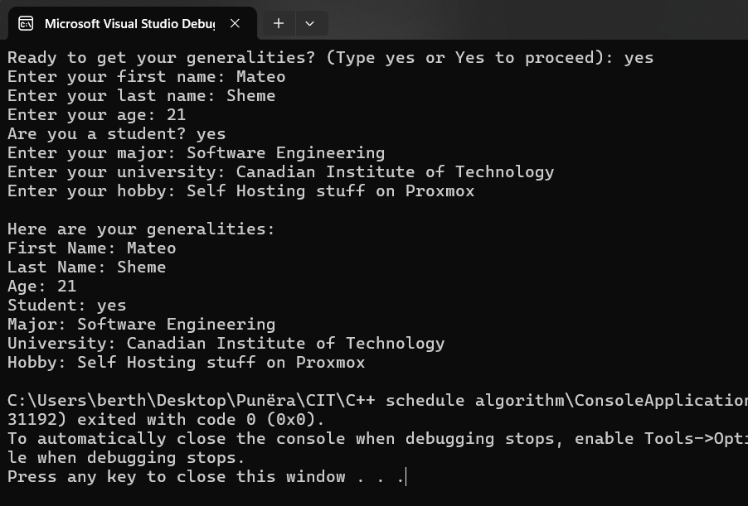
Output
01
02
03
04

Slide 17
03
Algorithm Code in C++
2022
01
02
03
04

Slide 18
Code
void initialize() {
reamining_time = burst_time;
response_time = -1;
}
};
int main() {
int num_of_processes;
cout << "Enter number of processes: ";
cin >> num_of_processes;
vector<Process> processes(num_of_processes);
for (int n = 0; n < num_of_processes; n++) {
processes[n].processID = n + 1;
cout << "\nEnter Arrival Time for Process P" << (n + 1) << ": ";
cin >> processes[n].arrival_time;
cout << "Enter Burst Time for Process P" << (n + 1) << ": ";
cin >> processes[n].burst_time;
#include <iostream>
#include <vector>
#include <algorithm>
#include <iomanip>
using namespace std;
class Process {
public:
int processID;
int arrival_time;
int burst_time;
int priority;
int reamining_time;
int response_time;
int completion_time;
int waiting_time;
int turn_around_time;
01
02
03
04

Slide 19
Code
for (int i = 0; i < num_of_processes; i++) {
if (processes[i].arrival_time <= current_time &&
processes[i].reamining_time > 0) {
if (processes[i].reamining_time < currentBestburst_time) {
current_best_processIndex = i;
currentBestburst_time = processes[i].reamining_time;
}
}
}
if (current_best_processIndex == -1) {
current_time++;
continue;
}
if (processes[current_best_processIndex].response_time == -1) {
cout << "Enter Priority for Process P" << (n + 1) << ": ";
cin >> processes[n].priority;
processes[n].initialize();
}
sort(processes.begin(), processes.end(),
[](const Process& a, const Process& b) {
return a.arrival_time < b.arrival_time;
});
int current_time = 0;
int completed_processes = 0;
while (completed_processes < num_of_processes) {
int current_best_processIndex = -1;
int currentBestburst_time = numeric_limits<int>::max();
01
02
03
04

Slide 20
Code
processes[current_best_processIndex].completion_time - processes[current_best_processIndex].arrival_time;
processes[current_best_processIndex].waiting_time =
processes[current_best_processIndex].turn_around_time - processes[current_best_processIndex].burst_time;
completed_processes++;
}
}
double sumresponse_time = 0;
double sumcompletion_time = 0;
double sumwaiting_time = 0;
double sumturn_around_time = 0;
cout << "\n\nProcess Details:\n";
cout << "-------------------------------------------\n";
cout << setiosflags(ios::fixed) << setprecision(2);
processes[current_best_processIndex].response_time = current_time - processes[current_best_processIndex].arrival_time;
}
processes[current_best_processIndex].reamining_time--;
current_time++;
if(processes[current_best_processIndex].reamining_time == 0) {
processes[current_best_processIndex].completion_time = current_time;
processes[current_best_processIndex].turn_around_time =
01
02
03
04

Slide 21
Code
sumresponse_time += processes[n].response_time;
sumcompletion_time += processes[n].completion_time;
sumwaiting_time += processes[n].waiting_time;
sumturn_around_time += processes[n].turn_around_time;
}
cout << "Average Turn Around Time: " << sumturn_around_time / num_of_processes << endl;
cout << "Average Waiting Time: " << sumwaiting_time / num_of_processes << endl;
return 0;
}
for (int n = 0; n < num_of_processes; n++) {
cout << "\nProcess P" << processes[n].processID << ":\n";
cout << "Burst Time: " << processes[n].burst_time << endl;
cout << "Response Time: " << processes[n].response_time << endl;
cout << "Completion Time: " << processes[n].completion_time << endl;
cout << "Waiting Time: " << processes[n].waiting_time << endl;
cout << "Turn Around Time: " << processes[n].turn_around_time << endl;
01
02
03
04

Slide 22
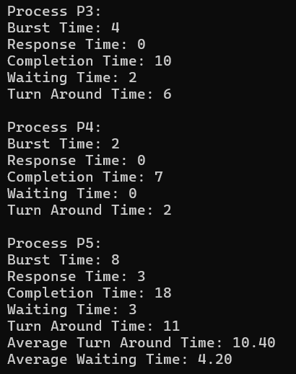
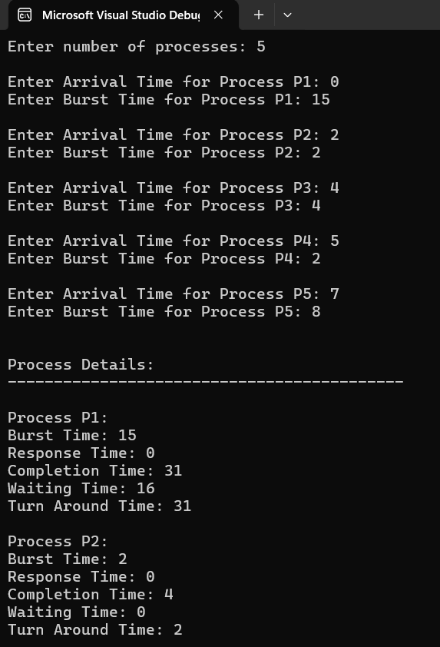
Output
01
02
03
04

Slide 23
Simulator
04
2022
01
02
03
04

Slide 24
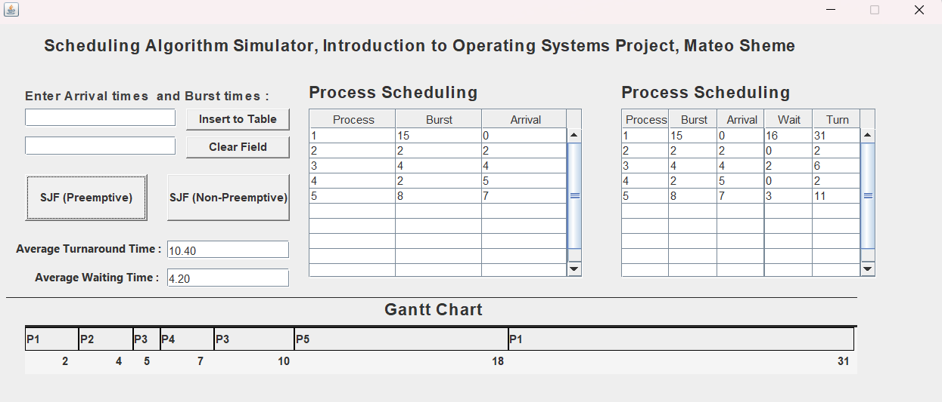
Simulator application with GUI in Java
01
02
03
04

Slide 25
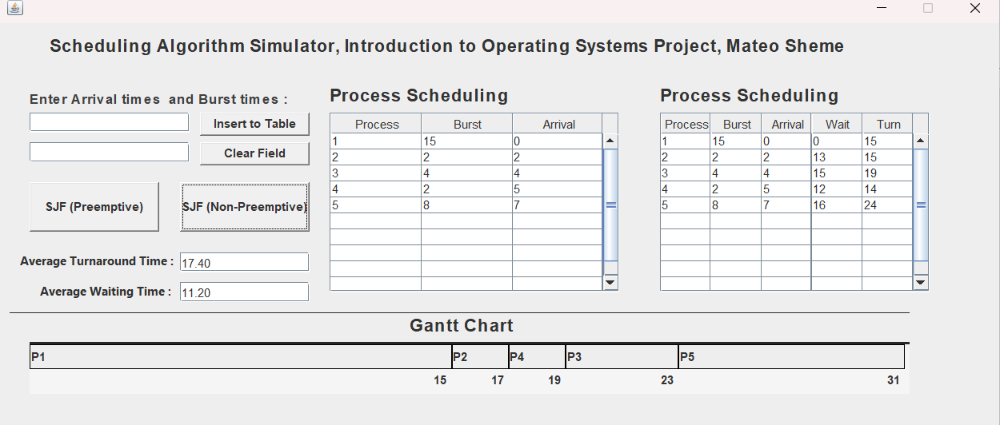
Simulator application with GUI in Java
01
02
03
04

Slide 26
Thank you!
01
02
03
04

